Slide 1
Personal Task Tracker
CS 5004 Final Project
Presented By Yu Fei Apr 23, 2024

Slide 2
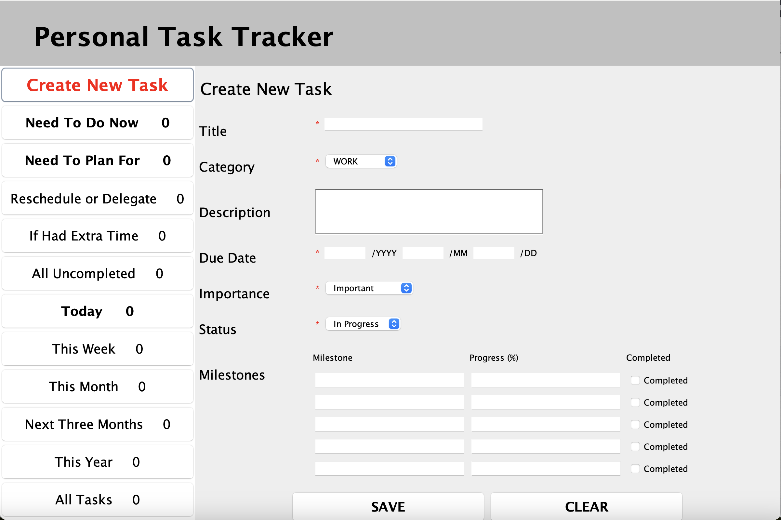
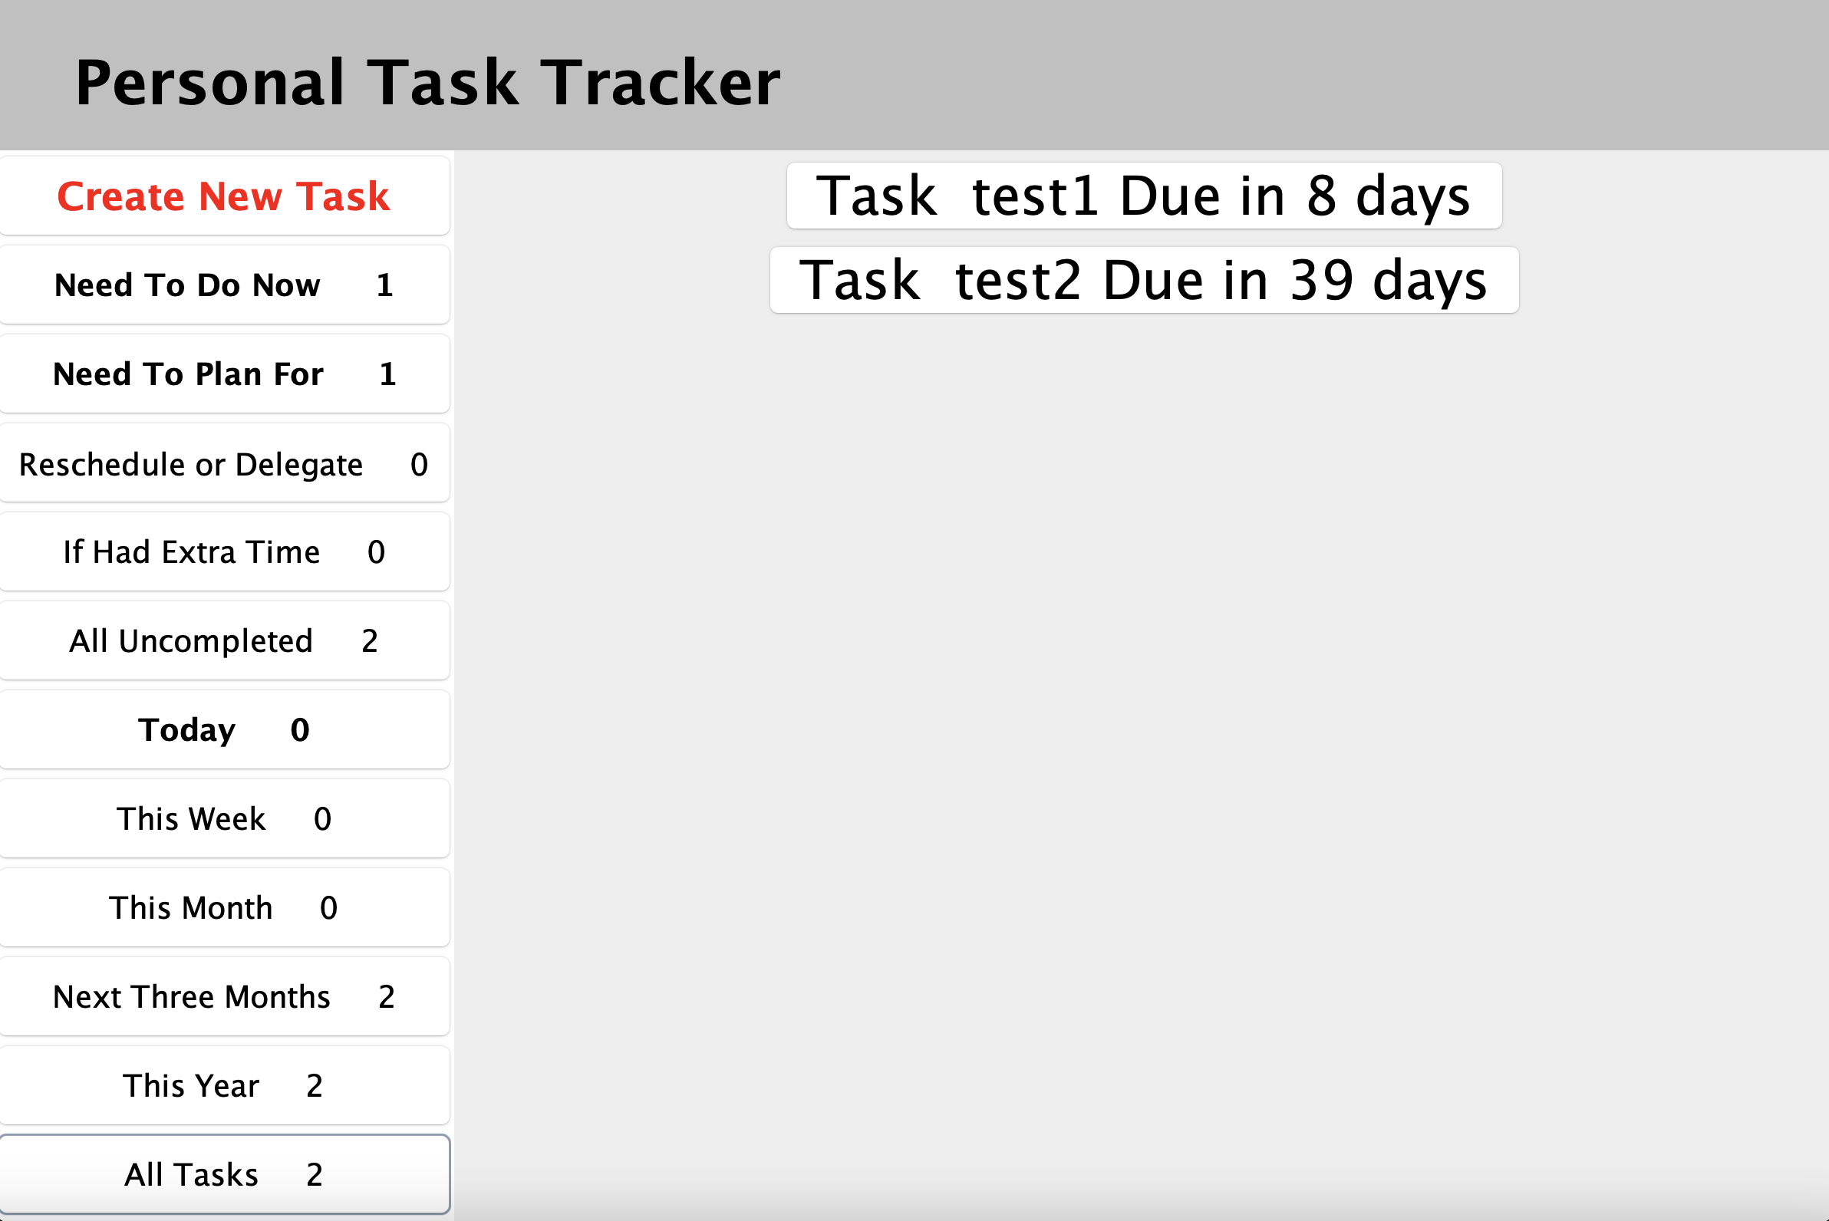
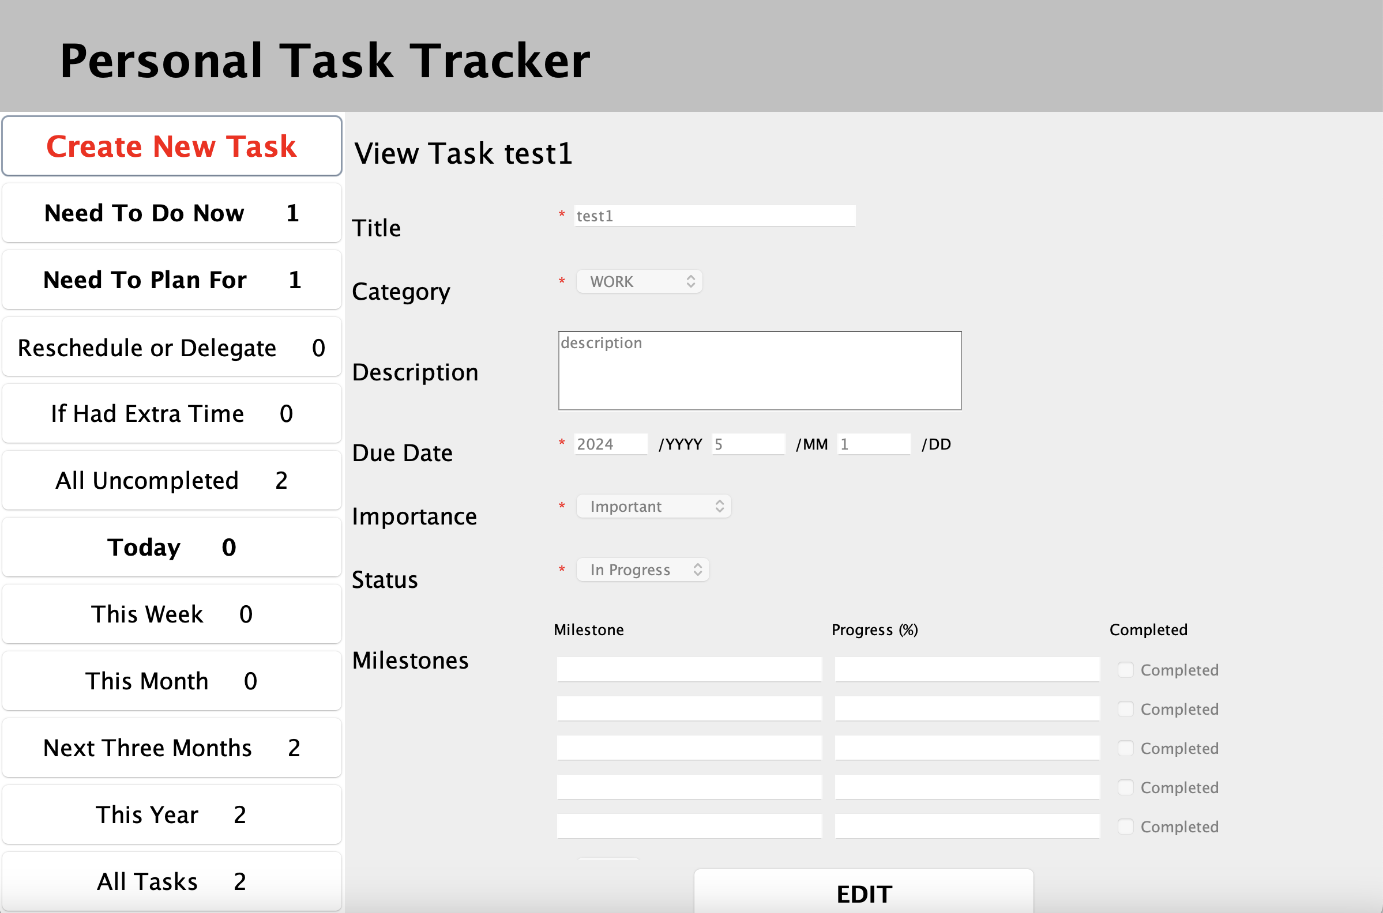
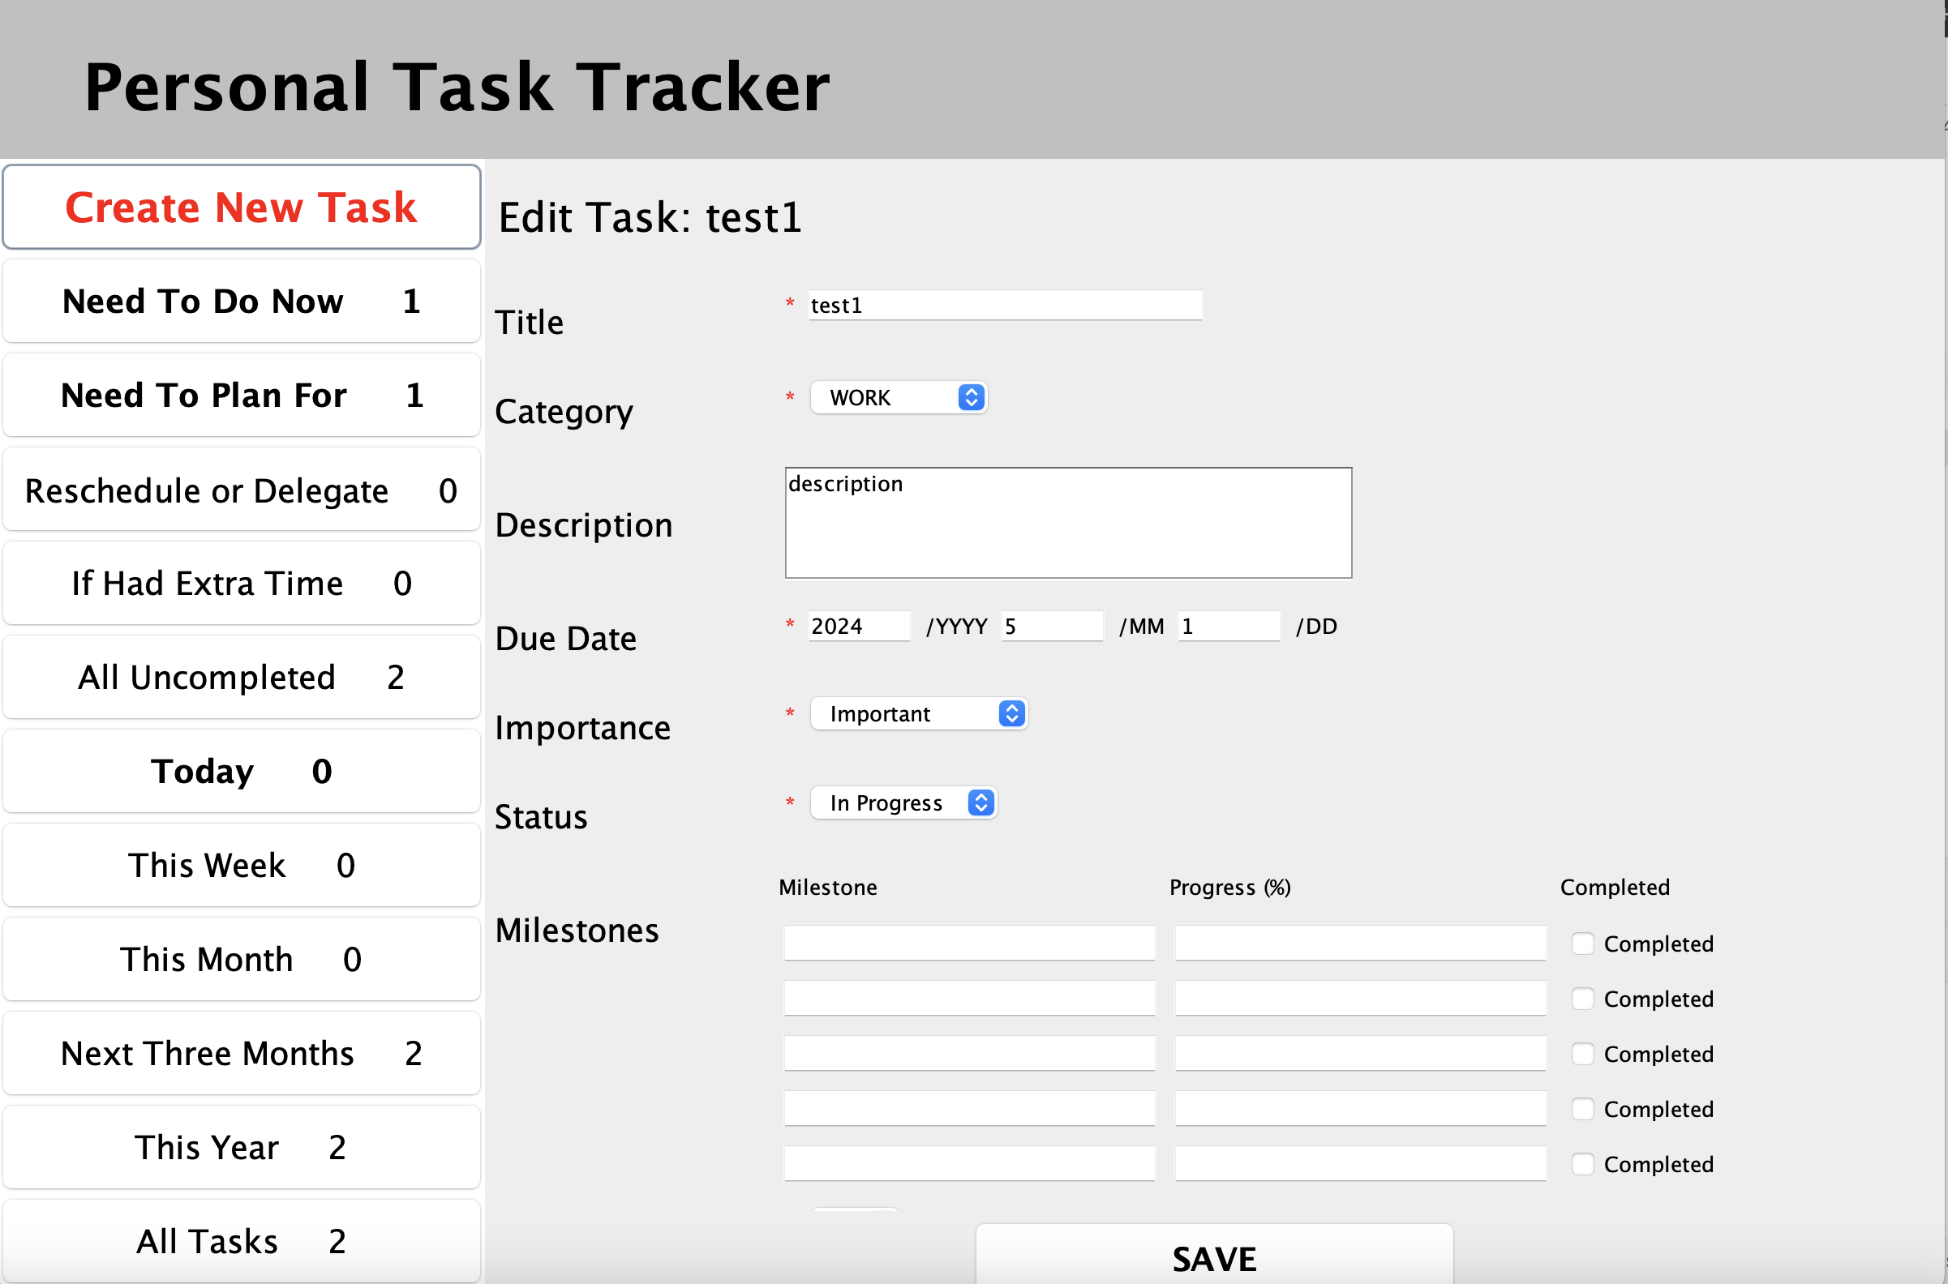

Personal Task Tracker
Goals & Rationale
Organization
A structured way to organize different tasks simultaneously based on categories, due date, priority and other criteria.
Prioritization
Enables users to identify high-priority tasks and allocate time and resources accordingly with multiple tasks.
Progress Tracking
Allows users to monitor the status of tasks, track milestones and view the progress from the start to end of tasks.
manage tasks more efficiently,
reduce stress,
and achieve goals with greater effectiveness
Create New Task
Filter & Sort Task
View Task
Edit Task

Slide 3
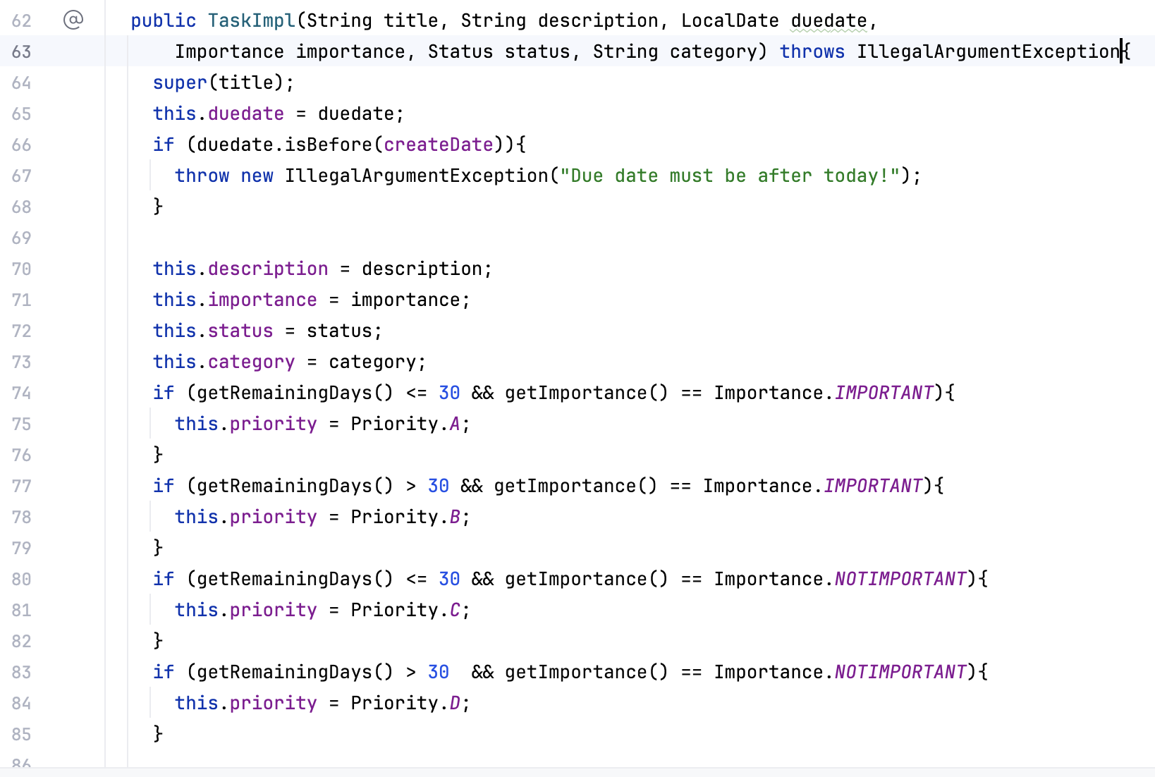
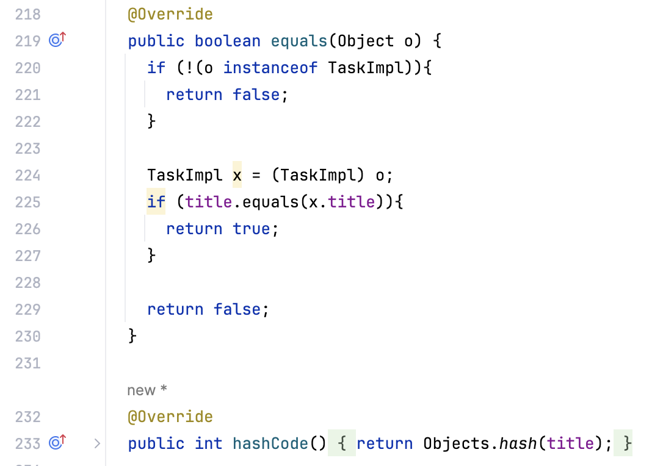
Task
TaskImpl
-title: String -description: String -duedate: LocalDate -importance: Importance -status: Status -milestones: Milestones -category: String -prority: Priority -progress: int -isCompleted: boolean -isDeleted: boolean -createDate: LocalDate
+getTitle(): String; +getDescription(): String +getDueDate(): LocalDate; +getPriority(): Priority +getCategory(): String; +getStatus(): Status +getProgress(): int; +getImportance(): Importance +getRemaningDays(): long; +getCreateDate(): LocalDate; +setTitle(String): void +setCategory(String): void; +setDescription(String): void +setDueDate(LocalDate): void +setPriority(Priority): void; +setStatus(Status): void +setMilestones(Milestones): void +setImportance(Importance): void +isCompleted(): boolean;; +isDeleted(): boolean +setCompleted(): void; +setDeleted(): void +equals(): boolean; +hashCode(): int
Milestones
-milestoneList: List<Milestone>
+getiIndex(int): Milestone +size(): int +allMilestones: List +deleteMilestone(Milestone) +equals: boolean +hashCode: int
Task
+getTitle(): String +getDescription(): String +getDueDate(): LocalDate +getPriority(): Priority +getCategory(): String +getStatus(): Status +getProgress(): int +getImportance(): Importance +getRemaningDays(): long +getCreateDate(): LocalDate +setTitle(String): void +setCategory(String): void +setDescription(String): void +setDueDate(LocalDate): void +setPriority(Priority): void +setStatus(Status): void +setMilestones(Milestones): void +setImportance(Importance): void +isCompleted(): boolean +isDeleted(): boolean +setCompleted(): void +setDeleted(): void
Abstract Task
#title: String #progress: int #isCompleted: boolean #isDeleted: boolean #createDate: LocalDate
+getTitle(): String +getProgress(): int +getCreateDate(): LocalDate +setTitle(String): void +isCompleted(): boolean +isDeleted(): boolean +setCompleted(): void +setDeleted(): void
Priority
Milestone
-title: String -progress: int -isCompleted: boolean -isDeleted: boolean -createDate: LocalDate
+getTitle(): String +getProgress(): int +getCreateDate(): LocalDate +setTitle(String): void +isCompleted(): boolean +isDeleted(): boolean +setCompleted(): void +setDeleted(): void +equals(): boolean; +hashCode(): int
Status

Slide 4
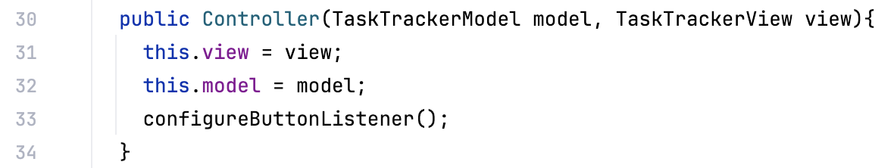
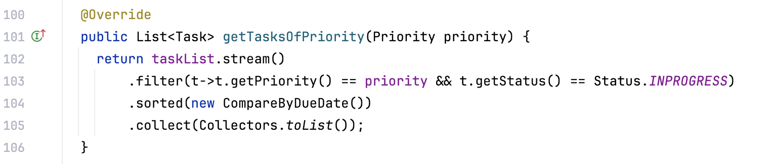
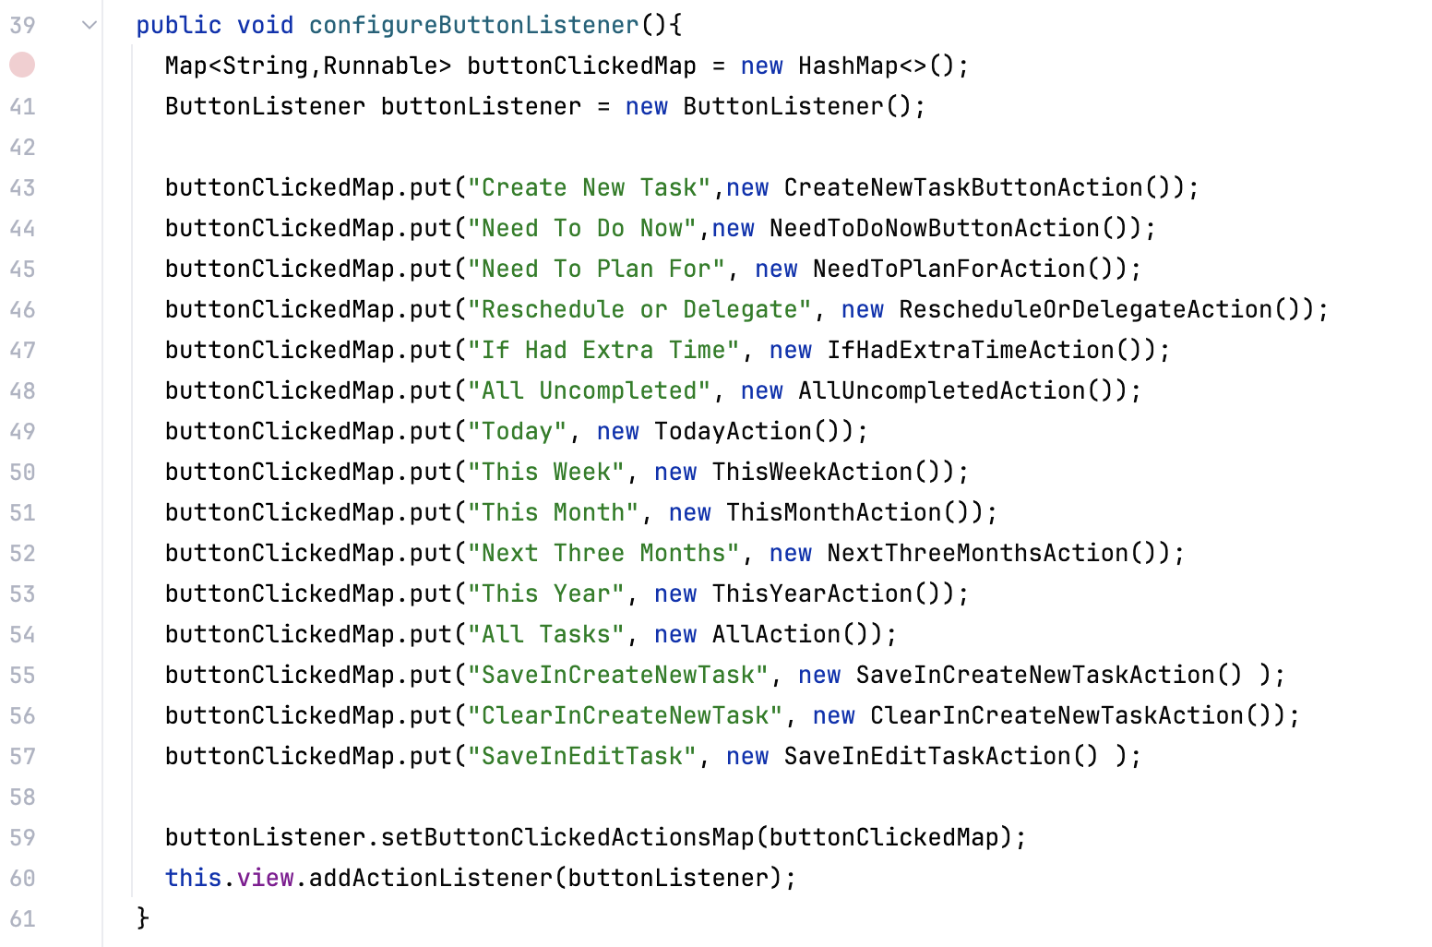
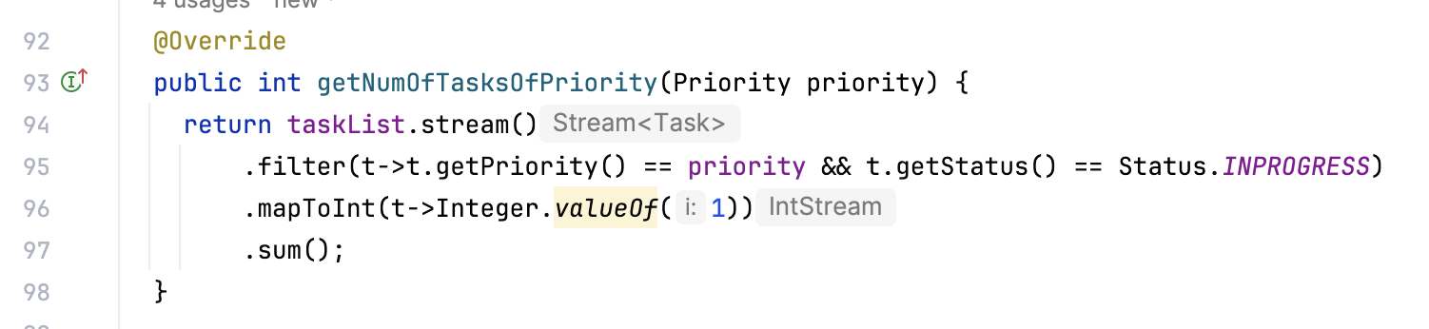
Tracker Overview
TaskTrackerView
+addCreateNewTaskPanel(): void +addTaskContextPanel(Task task): void +addTaskListPanel(List<Task>): void +addEditTaskPanel(Task): void +getInputTitle(): String +setInputTitle(String): void +getInputDescription(): String +setInputDescription(String): void +getInputCategory(): String +setCategory(String): void +getInputDueMonth(): String +getInputDueDay(): String +getInputDueYear(): String +setDueDate(LocalDate): void +getInputStatus(): Status +setInputStatus(Status): void +getInputImportance(): Importance +setInputImportance(Importance): void +getInputPriority(): Priority +setInputPriority(Priority): void +clearAllInput(): void +saveInNewDialog(): void +saveErrorInNewDialog(String): void +updateMenuPanel(List<Integer>): void +dateErrorOptionPane(): void +milestonesErrorPane(): void +milestoneProgressErrorPane(): void +getMilestoneTextInputList(): List<String> + getMilestoneProgressInputList(): List<String> +setMilestoneTextInputList(Task): void +setMilestoneProgressInputList(Task): void +getMilestoneCompletedInputList(): List<Boolean> +setMilestoneCompletedInputList(Task): void +setMilestoneTextInEditTask(Task): void +setMilestoneProgressInEditTask(Task): void +setMilestoneCompletedInEdit(Task): void +getSelectedTask(): Task +addActionListener(ActionListener): void
Controller
-model: TaskTrackerModel -view: TaskTrackerView
+configureButtonListener(): void
TaskTrackerModel
+addTask(Task): void +editTaskTitle(Task): void +editTaskCategory(Task, String): void +editTaskDueDate(Task, LocalDate): void +editTaskDescription(Task, String): void +editTaskPriority(Task, Priority): void +editTimeFrame(Task, Milestone): void +editTaskStatus(Task, Status): void +deleteTask(Task): void +getTasksOfPriority(Priority priority): List<Task> +allTasks(): List<Task> +getTasksUncompletedBefore(LocalDate date): List<Task> +getNumOfAllTasks(): int +getNumOfTasksOfPriority(Priority priority): int +getNumOfTasksUnCompleted(LocalDate): int +getMenuListNumber(): List<Integer> +getNameList(): List<String>
TaskTrackerImpl
-taskList: List<Task>
+addTask(Task): void +editTaskTitle(Task): void +editTaskCategory(Task, String): void +editTaskDueDate(Task, LocalDate): void +editTaskDescription(Task, String): void +editTaskPriority(Task, Priority): void +editTimeFrame(Task, Milestone): void +editTaskStatus(Task, Status): void +deleteTask(Task): void +getTasksOfPriority(Priority priority): List<Task> +allTasks(): List<Task> +getTasksUncompletedBefore(LocalDate date): List<Task> +getNumOfAllTasks(): int +getNumOfTasksOfPriority(Priority priority): int +getNumOfTasksUnCompleted(LocalDate): int +getMenuListNumber(): List<Integer> +getNameList(): List<String>

Slide 5
Model, View, Controller
Property
Update
Controller
Controller ButtonListener CreateNewTaskButtonAction NeedToDoNowButtonAction NeedToPlanForAction RescheduleOrDelegateAction IfHadExtraTimeAction AllUncompletedAction TodayActionThisWeekAction ThisMonthAction NextThreeMonths ActionThisYearAction SaveInCreateNewTaskAction ClearInCreateNewTaskAction SaveInEditTaskAction
Component
Update
Model
TaskTrackerModel TaskTrackerImpl
View
TaskTrackerView JFrameView
Property
Change
User
Action

Slide 6
Lessons Learned
Abstraction:
Task, AbstractTask, TaskImpl, Milestones
Other things being equal, prefer Composition over inheritance
JFrameView
A thorough understanding of Swing
Timely testing is so important
Javadoc all public classes and methods.

Slide 7
Limitations & Future Extensions
Functions
Build connection/dependencies between different tasks
Search based on categories/key words/hashtags
Save the progress of the task management program (JSON)
Integrate with database (MySQL)
Generate regular reports and analysis of tasks based on AI
Different types of users: individual & company (beyond “personal”)
UI
Different UI
Visualize: progress bar, time reminders
Reference
[1]K. Bates, Head First Java, 3Rd Edition. S.L.: O’reilly Media, Inc, Usa, 2021.
[2]“Java To Do List App,” www.youtube.com. https://www.youtube.com/watch?v=BQXjF7tw_MQ [3]“Trail: Creating a GUI With JFC/Swing (The JavaTM Tutorials),” Oracle.com, 2019. https://docs.oracle.com/javase/tutorial/uiswing/
[4]GeeksforGeeks, “Introduction to Java Swing,” GeeksforGeeks, Feb. 15, 2022. https://www.geeksforgeeks.org/introduction-to-java-swing/
‌
‌

